Slide 1
Module 3
Predicting Financial Distress & Indicators of Crisis across your Business
The European Commission support for the production of this publication does not constitute an endorsement of the contents which reflects the views only of the authors, and the Commission cannot be held responsible for any use which may be made of the information contained therein.

Slide 2
What you will learn from Module 03 ..
In Module 03, Predicting Financial Distress & Indicators of Crisis across your Business, you will benefit from learning to
The Power of Management Instruments – the essential control instruments you need
Controlling a Crisis
Fact-based management – deep give into the vital role of KPIs
The Financial Ratios you need to know
Key Information Sources in the business – the indicators of crisis across all business operations

Slide 3
The Power of Management Instruments

Slide 4
Have you a Management Plan ? A reminder of the Essentials of Management Planning.
In many life situations we need management skills. We plan and prepare ourselves, make well-balanced decisions and are aware of the consequences.
Often, however, these skills are not applied in small and medium-sized companies.
Plan your trip...
When you plan a trip
Select destination
  select best route
  shortest route
  fastest route
  most pleasant route
Check while driving
  Is the path still right?
  Must you stop?
  Do you have to stay overnight?
Are there traffic jam warnings?
How much fuel is used?
When you plan your business
Planning the financial year
Planning of the company
  plan lower costs
  plan higher sales
  Avoid bottlenecks (in liquidity)
Consider planning results
  Is the planning adhered to?
  Plan/actual deviations?
  Does anything need to be
  changed?
Is the cash flow sufficient?
How high was the interest expense?

Slide 5
The Essential Management Control Instruments you need:
Monthly Evaluations
Basic business concerns:
Where does my company stand financially today?
What are my cost drivers?
Where has my money gone?
First Step: Analyze Monthly Business evaluations
Monthly Business Evaluations –
What's in it and who benefits from it?
Summary of the current status of financial accounting from a business perspective
Income
Liquidity
Assets
For the Management as
Overview of business development during the year
Controlling and management tool
Action indicator
For the Bank
  for the assessment of your customer during the year
  as a replacement document
  for the rating, possibly as an occasion for discussion
10,000,000

Slide 6
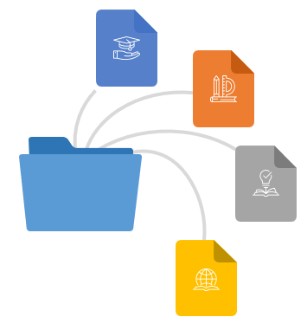
The Essential Management Control Instruments you need:
Secure Liquidity
What can the entrepreneur achieve by sharing live financial information with the bank and other financial stakeholders?
Expressing open-mindedness
Create trust
Positive influence on the rating
Negotiate better terms
Reduce queries
Document business management competence
Robust liquidity control is the cornerstone for building trust with your financiers (equity and debt capital).

Slide 7
Recognise Chronic Problems
- Improvement instead of Fire Fighting
Improvement
Firefighting
Firefighting is a vicious circle. Because you don't have the resources to tackle the root of the problems, no lasting improvements are achieved.
Controlling helps you to leave the firefighting mode.
Fire Prevention
Focused on attaining a new level of performance that is superior to any precious level.
Accomplished through breakthrough
Improves chronic level of performance
Accomplished with corrective action to put out a fire.
Improves sporadic level of performance.
Troubleshooting

Slide 8
Controlling a Crisis

Slide 9
What is Controlling?
Controlling is a communicative process - and as such has potential for conflict. Controlling restricts freedom - in support of goal-orientation.
Controlling means...
the management process aimed at ensuring sustainable profitability
the business management
Target acquisition,
Planning and
Control system of a company.
(Source: DIN SPEC 1086, preamble).
Performance
Contribution
Goal
Achievement
Requirements
Agreement and
project planning
Evaluation and
Reporting
Controlling
Efficiency
Effectiveness
Actions
Coordination and
Implementation

Slide 10
What is the role of a Controller?
As a partner in the management process, the controller supports the business owner/manager by:
Reducing the burden on management, especially by providing factual knowledge
Leadership supplementation through the introduction of other perspectives (e.g. methodological knowledge, supplementation of a more intuitive manager's decision making through reflective analysis)
Leadership limitation by avoiding opportunistic behaviour of managers
Manager
Is responsible for the results
Dialogue
Examine Measures /
Agree on Goals /
Stay the Course
Controller
Is responsible for the
transparency of the results

Slide 11
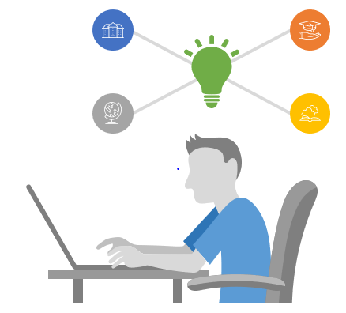
What is the role of a Controller?
Among the central tasks of controlling is the analysis of the creditworthiness and reliability of your business partners. The credit information on a company generally consists of
Creditworthiness information (credit index, payment method, credit rating, maximum credit per order)
Structural information (legal form, date of foundation, registration information, company organs and shareholdings, object of the company, industry)
Financial information (capital, annual turnover, real estate, assets/liabilities)
Other information (company development with order situation, employees, bank details, notes on investments, history)

Slide 12

Fact-based management - deeper dive into the vital role of KPIs

Slide 13




Key Performance Indicators (KPIs)
The assessment of KPIs often leads to the identification of potential improvements AND understanding of an upcoming crisis .
Choosing the right KPIs is reliant upon having a good understanding of what is important to the organization and its success
KPIs are commonly used by a business to evaluate its success or the success of a particular activity it is engaged.
KPI stands for Key Performance Indicator - and that's what it's all about - identifying, measuring and controlling the key indicators of the company's performance

Slide 14
What KPIs are – and are not!
With many different goals and targets, business owners and their employees can easily lose track of what is really important between
You need few and simple key figures that tells you whether you are on track or not. To do this, KPIs must meet a few basic requirements
Quantifiable / measurable and actionable
Measure factors that are critical to the success of the organization
Tied to business goals and targets
Limited to the real important metrics
Applied consistently throughout the company
Metrics that are vague or unclear
“Nice to knows” or metrics that are not actionable
Reports
Exhaustive set of metrics
Refutable
What KPIs
are
What they are
not

Slide 15
5 Key Steps in the KPI Process
Depending upon the area of business performance being measured, the frequency with which KPIs need to be reviewed may differ. Accurate measurement of performance can only be obtained if a schedule of periodic review is defined and strictly adhered to.
Identify
Create
Evaluate
Change
Assess
Create Dashboards or scorecards to measure and display KPI results
Evaluate how well business goals are being met based on the KPIs
Change strategies and processes as needed to improve the performance
Assess whether the KPIs still align with goals and adjust them if needed
Identify a set of relevant KPIs to track a company or business unit

Slide 16

Structured approach to select the right KPIs
To find the right KPIs for your business, you should follow a structured approach. Brainstorm and collect potential KPIs, eliminate those you don’t need and set up a KPI library to keep the likely ones. Those KPIs should be discussed within the team. Those selected need to be translated to operational formats and should be validated in an internal case study.
External
Experts
Implementation
Too few KPIs will make it difficult for your organization to properly measure critical areas of performance. However, too many will hamper transparency.
Approximately four to 10 different KPIs for each area of focus should be enough to give decision makers a strong point of focus.
Selection
Process
Operationalization
Internal Case Study
Validation
SMART Principle
Internal Review
Monitor
Initial
Proposal
Elimination
Internal KPI
Library

Slide 17
SMART KPIs
Any goals you set for your business – including your KPIs – should be specific, measurable, achievable, reachable, and timely (S.M.A.R.T.).
Without these five components, your KPIs will either be impossible to reach or worthless in the long run. Work with key decision makers and members from within the organization to ensure that every stakeholder feels the KPIs you have set are suitably S.M.A.R.T.
Specific
Measurable
Achievable
Relevant
Time
Framed
What exactly is an indicator for Success?
Can you physically track your KPIs
Are your KPIs realistic?
Do your KPIs reflect the overall goals of the business?
When should KPIs be met?

Slide 18
Information sources and areas to look for
In Module 1 we presented the Value Chain (Porter) and used it to illustrate possible causes of the crisis.
Now we want to use this concept to go deeper into that valuable information for early crisis detection across all business functions.
Almost every company has a wealth of information that can also be used for early crisis detection at little extra cost.
PRIMARY ACTIVITIES
INBOUND
LOGISTICS
OPERATIONS
OUTBOUND
LOGISTICS
MARKETING
AND SALES
SERVICE
VALUES
FIRM INFRASTRUCTURE
HUMAN RESOURCE MANAGEMENT
TECHNOLOGY DEVELOPMENT
PROCUREMENT
SUPPORT ACTIVITIES

Slide 19
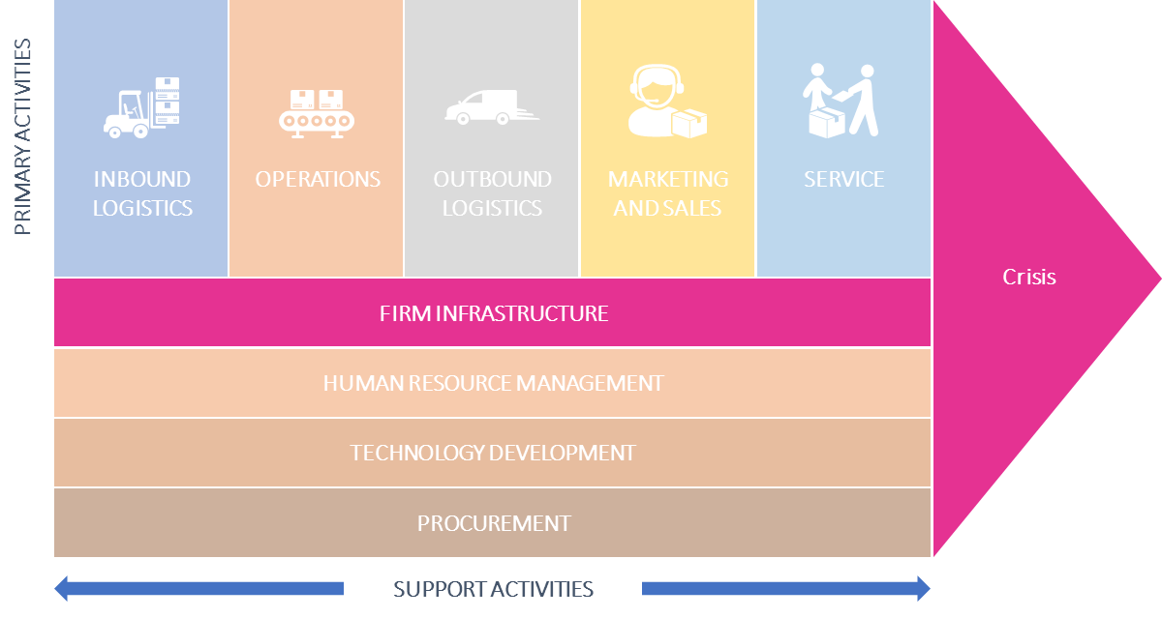
Infrastructure:
Key Performance (Risk) Indicators
There are a number of key figures that are suitable for indicating crises at an early stage - or are able to help prevent them. This is especially true if the key figures are regularly analysed over time and developments are kept in mind.
The information necessary to determine these key figures is readiliy available in almost all companies without additional effort or can be acquired with little effort.
Liquidity
Quick Ratio
Net Working Capital
Accounts Payable /Accounts Receivable
Cost Structure
Cost of materials ratio
Personnel deployment ratio
Profitability
Operating profitability
Return on investment (ROI)
Capital Structure
Equity ratio
Debt ratio
Net indebtedness
Capital commitment period
Dynamic debt-equity ratio
Activity
Sales growth
(DPO) Days Payables Outstanding
(DSO) Days Sales Outstanding
(DIH) Days Inventory Held

Slide 20
The Financial Ratios you need to know

Slide 21
The Financial Ratios you need to know
Liquidity Ratios
Liquidity ratios are the ratios that measure the ability of a company to meet its short-term debt obligations.
The liquidity ratios are a result of dividing cash and other liquid assets by the short-term borrowings and current liabilities. They show the number of times the short-term debt obligations are covered by the cash and liquid assets. If the value is greater than 1, it means the short-term obligations are fully covered.
Debt-to-Assets Ratio
= Total Debt / Total Assets
Debt-to-Equity Ratio
= Total Debt / Total Equity
= Today Debt / (Total Debt + Total Equity)
Debt-to-Capital Ratio
Debt-to-EBITDA Ratio
= Total Debt / Earnings Before Interest Taxes Depreciation & Amortization (EBITDA)
Asset-to-Equity Ratio
= Total Assets / Total Equity

Slide 22

Gross Profit Margin
If a company's gross profit margin wildly fluctuates, this may signal poor management practices and/or inferior products. Such fluctuations may be justified in cases where a company makes sweeping operational changes to its business model, in which case temporary volatility should be no cause for alarm. E.g. if a company decides to automate certain supply chain functions, the initial investment may be high, but the cost of goods ultimately decreases due to the lower labor costs.
Gross profit margin is a metric analysts use to assess a company's financial health by calculating the amount of money left over from product sales after subtracting the cost of goods sold (COGS).
Sometimes referred to as the gross margin ratio, gross profit margin is frequently expressed as a percentage of sales.
What does it tell you
A company's gross profit margin percentage is calculated by first subtracting the cost of goods sold (COGS) from net sales (gross revenues minus returns, allowances, and discounts). This figure is then divided by net sales, to calculate the gross profit margin in percentage terms.
How to calculate
Formula
$$Gross Profit Margin= \frac{Net Sales −COGS}{Net Sales}$$

Slide 23

Operating Profit Margin
A slightly more complex metric, operating profit also takes into account all overhead, operating, administrative and sales expenses necessary to run the business on a day-to-day basis.
While this figure still excludes debts, taxes and other non-operational expenses, it does include the amortization and depreciation of assets.
A company's operating profit margin ratio tells you how well the company's operations contribute to its profitability. A company with a substantial profit margin ratio makes more money on each EURO of sales than a company with a narrow profit margin.
What does it tell you
Find the operating income (EBIT) by subtracting its operational expenses, allocated depreciation, and amortization amounts from gross income.
Find the net sales revenue. This requires no calculation because the sales shown on the company's income statement are net sales. If that figure is unavailable, you can calculate net sales by taking the company's gross sales and subtracting its sales returns, allowances for damaged goods, and any discounts offered.
Calculate the operating profit margin ratio by dividing the figure from step one (operating income) by the figure from step two (net sales).
How to calculate
Formula
$$Operating Profit Margin= \frac{Operating Income}{Revenue }∗100$$

Slide 24

Net Profit Margin
The net profit margin can be used to compare performance over different periods. However, this only reveals reliable results if nothing else has changed in your expenses.
What does it tell you
The net profit margin can indicate how well the company converts its sales into profits. This means that the percentage calculated is the percent of your revenues that are profitable. It also indicates the amount of revenue you are spending to produce your products or services.
You'll have to calculate net profit and net sales, as there are generally not line items labeled as such on the income statement. Net profit is calculated by subtracting all of your expenses from your revenues. These include wages, salaries, utilities, or other expenses.
Net sales is the result of subtracting your allowances, returns, and discounts from your total revenue. Allowances stem from problems with a product or service which required you to reduce the price to satisfy the customer. A return is the return of an item or a refund for a service.
How to calculate
Formula
$$Net Profit Margin= \frac{Net Profits}{Net Sales }∗100$$

Slide 25

Important Financial Ratios: Current Ratio
The current ratio is probably the best known and most often used of the liquidity ratios, which analysts and investors use to evaluate the firm's ability to pay its short-term debt obligations, such as accounts payable (payments to suppliers) and taxes and wages.
Short-term notes payable to a bank, for example, may also be relevant.
The current ratio shows how many times over the firm can pay its current debt obligations based on its current, most liquid assets.
If a business firm has €200 in current assets and €100 in current liabilities, the calculation is €200/€100 = 2.00X. The "X" (times) part at the end means that the firm can pay its current liabilities from its current assets two times over.
This is a good financial position for a firm, meaning that it can meet its short-term debt obligations with no stress. If the current ratio is less than 1.00X, then the firm would have a problem covering its monthly bills. A higher current ratio is typically better than a lower current ratio with regard to maintaining liquidity.
What does it tell you
How to calculate
The current ratio is calculated from balance sheet data using the following formula:
Formula
$$Current Ratio= \frac{Current Assets}{Current Liabilities}$$

Slide 26
Key Information Sources in the company

Slide 27
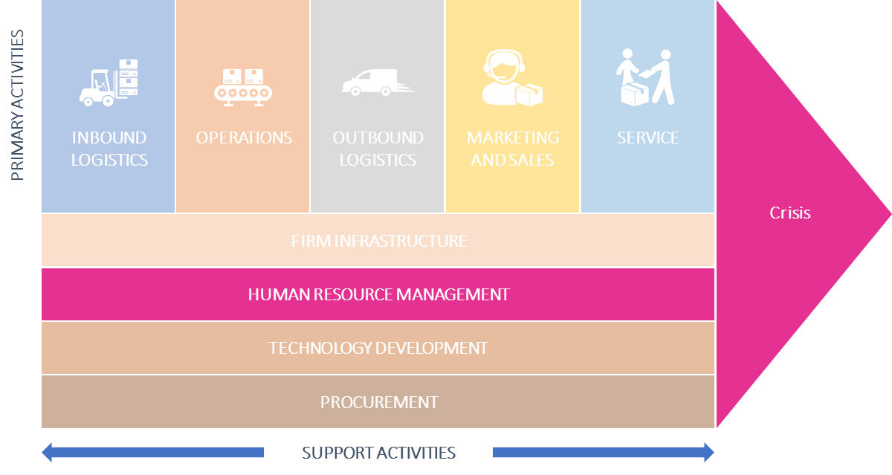
Information sources in the company: HR
A large number of indicators for crises in early phases can be determined from the personnel department.
Employees usually have a very sensitive feeling for the company - even if they do not articulate it directly.
With relatively little effort you can generate important information about the state of the company – especially when you review them over time
Sick
Leave
Did the percentage of
sick leaves change over time?
Do less people send you initiative Applications?
Initiative
Applications
Time until
positions
can be re-staffed
Is it more difficult to re-staff positions or do you need to pay more to convince candidates?
Do you track online platforms for ratings of Employers?
Online Ratings
as Employer
Agony
Box
Do your employees have the chance to mention important topics anonymously?
What are the topics your employees rate as important?
Employee
surveys
Staff
Interviews
Do you conduct regular Staff Interviews? Are they open to for constructive feedback?
Do you have a constructive, open company culture? Did Mood and Motivation change?
Feedback
Culture

Slide 28
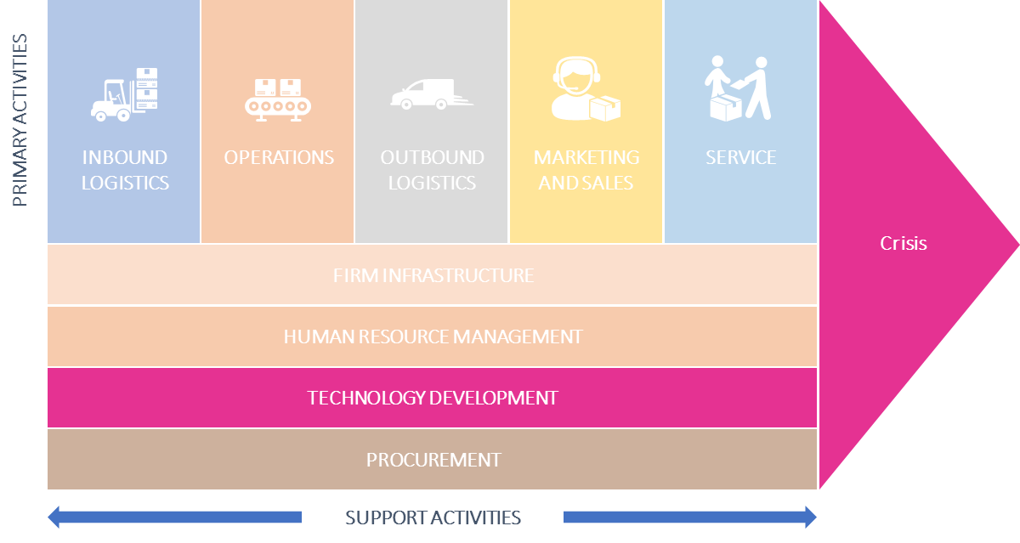
Information sources in the company: R&D
The R&D Department or responsible person develops the innovations that are essential for the sustainable success of the company. Therefore, it is especially in this area that it should be looked at to see whether there are signs of a deterioration in performance.
Opposite are a few key figures that can reveal the first warning signs.
# Time needed to prepare
Innovations / Patent Claims
€ Cost savings achieved due
to R&D / Innovations
# of Engineers /
Staff with PhD Degrees
# New Products per
R&D Staff
€ Invested in R&D
per € of Sales
# First to market products
# Number of Product Development
Products in Pipeline

Slide 29
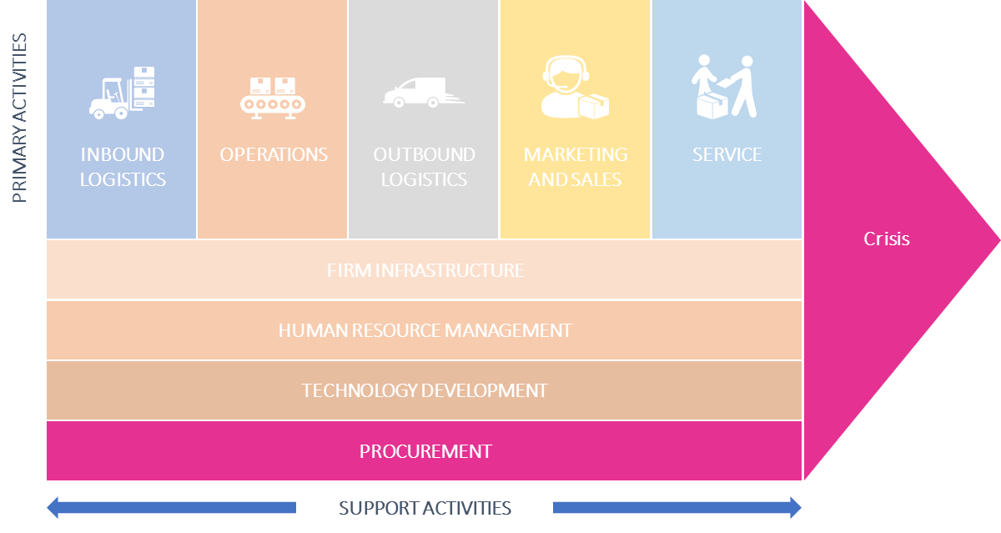
Information sources in the company: Procurement
In many business models, purchasing represents a central cost block and the supply chain is a key success factor. Nevertheless, surprisingly few companies have a transparent overview of the purchasing area.
Compliance Rate
Understand if suppliers fulfil your requirements
Number of
Suppliers
Track your level of dependency towards your suppliers
Purchase order
cycle time
Know who to address your urgent orders to
Supplier
Availability
Measure suppliers’ capacity to respond to demand
Supplier Defect
Rate
Evaluate your suppliers’ individual quality
Cost of Purchase
order
Control the internal costs incurred by each purchase
Procurement
Cost Reduction
Streamline the tangible costs savings

Slide 30
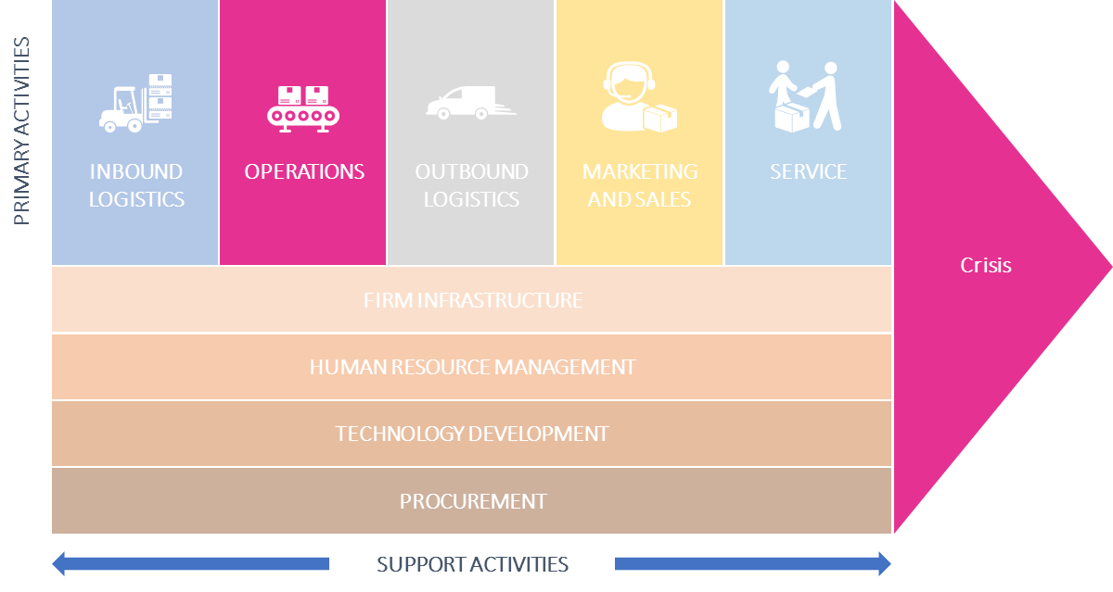
Information sources in the company: Operations
An operational KPI is a quantifiable value expressing the business performance in a shorter time-frame level. They are used in different industries to track organizational processes, improve efficiency and help businesses to understand and reflect on the outcomes.
Choosing the right KPIs is of course depended on your business model.
Here are some examples of indicators from manufacturing
Production Volume
Track the quantities that you can produce
Production
Downtime
Analyse and optimize your maintenance
Production Costs
Monitor the costs implied in the production
Rate of Return
Measure how many items are sent back
Right first time
Understand the performance of your production process
Asset Turnover
Acknowledge your assets in relation to your revenue
Unit Costs
Track and optimize your unit costs over time

Slide 31
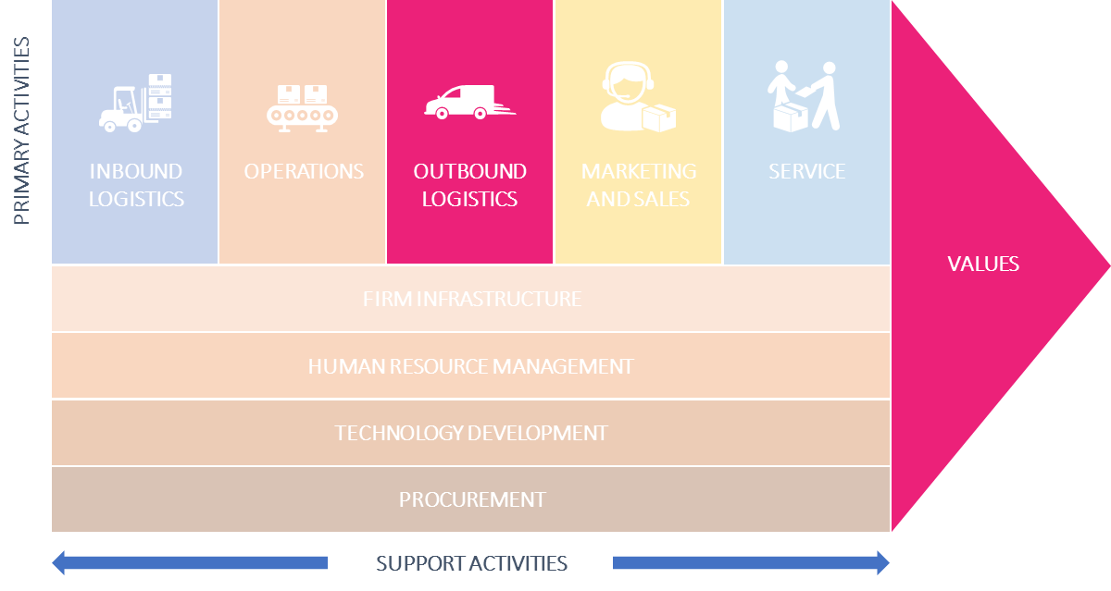
Information sources in the company: Outbound Logistics
A logistics KPI or metric is a performance measurement that is used by logistics managers to track, visualize and optimize all relevant logistic processes in an efficient way.
Among others, these measurements refer to transportation, warehouse and supply chain aspects.
Shipping Time
Spot potential issues in your order fulfilment process
Order Accuracy
Monitor the degree of incidents
Delivery Time
Track your average delivery time in detail
Transportation
Costs
Analyse all costs from the order placement to delivery
Warehousing
Costs
Optimize the expenses of your warehouse
Number of
Shipments
Understand how many orders are shipped
Inventory
Accuracy
Avoid problems because of inaccurate inventory

Slide 32
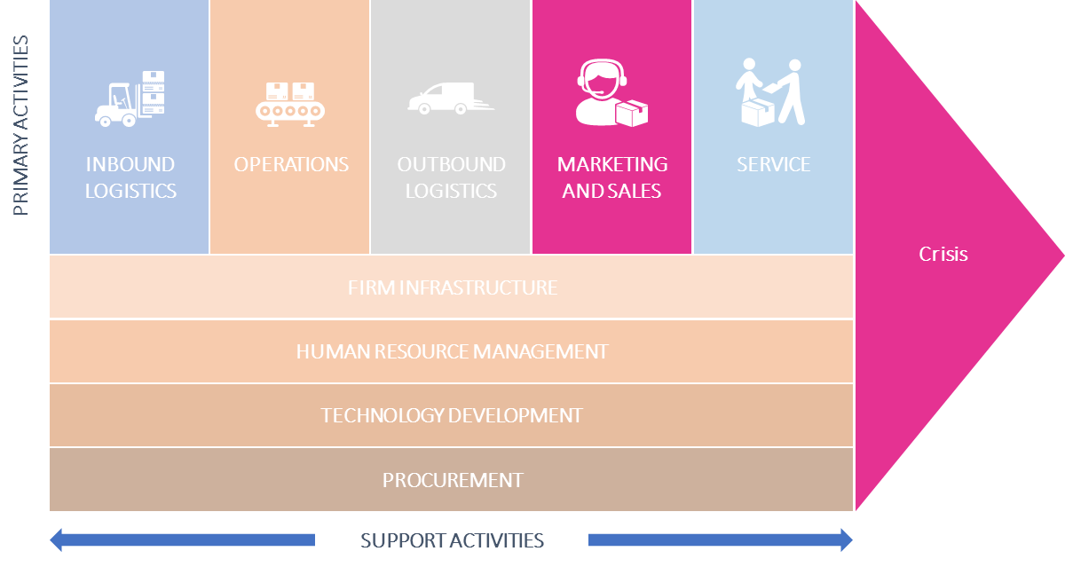
Information sources in the company: Marketing and Sales
Since the company's marketing and sales department has its ear directly to the customer, we will deal intensively with this area later in this course.
Here we will give you a short overview about Customer related metrics that are worth to be evaluated.
Costs per
Acquisition
Are your customer acquisition costs viable?
Cost per Lead
How much should you spend per lead?
Sales Targets
Is your sales growing and reaching its targets?
Return on Marketing
Investments
How efficiently are you spending your marketing budget?
Customer Lifetime
Value
Are new customers profitable in the long-run?

Slide 33
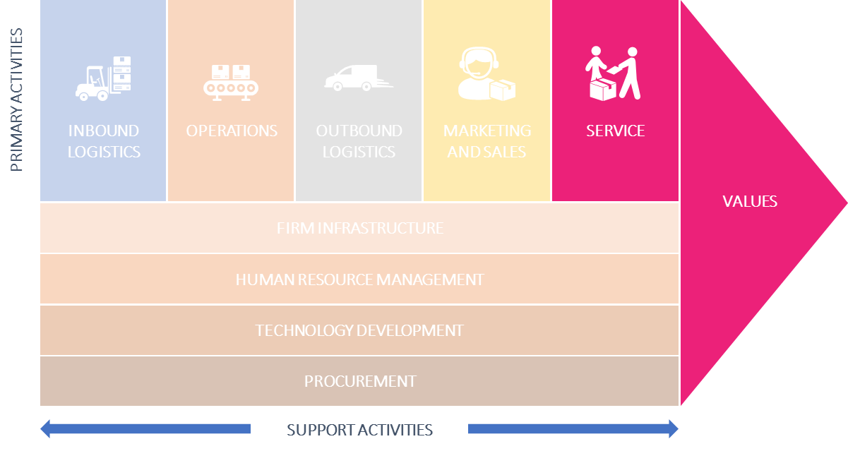
Information sources in the company: Service
If you do not measure the quality of your customer service, how do you want to judge the success of your actions?
If you are seriously interested in improving your customer service then you need to review your KPIs.
Customer
Satisfaction
Customer satisfaction is everything. Measuring customer satisfaction is difficult
Net Promoter
Score
The NPS measures the probability with which your customers recommend you to another person.
First Response
Time
Speed is a decisive factor for customer satisfaction
Customer
Churn Rate
Customer churn helps you see trends in product satisfaction (or dissatisfaction)
ServeQual
Quality of service + Customer satisfaction

Slide 34
The absolute minimum you should monitor
By defining relevant observation areas and selecting suitable early detection indicators (see opposite), changes in the market and in the company can be systematically identified and monitored. By significantly changing an indicator, a signal is given to discuss and, if necessary, initiate measures.
→ There is a number of minimum areas you should constantly observe.
Capital Market
Cyclical/structural developments
Interest, exchange rates
Orders received / Business climate /
Consumer sentiment
Financials
08
07
Technology / R&D
Short-term liquidity planning /
3 Year Planning /
1 Year Forecast /
Accounts Receivable /
Accounts Payable
01
New process + technologies / Consumer behavior / Number of current development projects / Number of own patents/ Licenses granted / Research and development costs
06
Employees
02
Sales
Fluctuation / Sick Leaves /
Age Structure
05
Number of enquiries per Period / Development of orders in your main industry (which will later affect your orders) / Revenues / Prices / Price and Product Strategy of your competitors / Lost Orders
03
Production
04
Age Structure of Machines / Investment Backlog / Capacity Utilization / Energy Consumption / Scrap / Cost of poor Quality / Maintenance Costs
Procurement
Raw Material prices / Stocks / Quality and Adherence to delivery dates of suppliers

Slide 35
NEXT UP MODULE 4
Risk Management + Root-cause-analysis

