Slide 1
MODULE 2
Scanning for Early Warning Signs
The European Commission support for the production of this publication does not constitute an endorsement of the contents which reflects the views only of the authors, and the Commission cannot be held responsible for any use which may be made of the information contained therein.

Slide 2
What you will learn from Module 02 ..
In Module 02, Scanning for Early Warning Signs, you will benefit from learning to
The Skills needed during a business crisis
Scanning for Early Warning Signs, 4 key areas
The 5 Steps of Stakeholder Management
Social Listening / Using Social Media for Early Warning
The 5 steps of Managing a Social Media Crisis
We invite you to deepen your learning by watching some insightful videos.

Slide 3
Specific skills needed at different stages of a crisis
While proactive action is necessary at the beginning in order to recognize crisis signals and to make the right preparations based on them - after the outbreak of the crisis the focus is on reactive capabilities.
In order to generate sustainable crisis resilience, the right lessons must be drawn after the crisis.
Proactive
Reactive
Crisis
1
3
2
4
Signal Detection
Containment/
Damage Limitation
Preparation
Recovery
Learning

Slide 4
Overview of the Skills needed during a Crisis
Very few managers combine all the necessary prerequisites for effective management in various crisis phases in one person.
The roles they have to take on are extremely different.
The art is to know your own strengths - and even more importantly your own weaknesses - in the individual phases and to build a crisis management team - if necessary, with external support.
01 Pre-Crisis
02 During Crisis
Scanning
Assessing Situation
Designing Tools & Systems
Monitoring
01
Detecting
Containing
Recovering
04
02
04 Learning
03 Post-Crisis
Learning from Failures
Implementing the right measures
Following Up
Shaping memories
Assessing effectiveness
03

Slide 5
Scanning for Early Warning Signs, 4 key areas

Slide 6
Scanning for Early Warning Signs, 4 key areas
A regular, systematic and comprehensive risk assessment across 4 key early warning/risk signs allows early countermeasures to be taken.
Let’s look at each of the 4 areas …….
Industry Issues
Organizational Issues
Systematic search for risks in the industry your company is working in
Analysis of risks arising from the own organisation
Stakeholder Relationships
Risk Assessments
Some risks arise from the specific relationships with stakeholders
Systematic scanning for implicit issues

Slide 7
1 Industry Issues - sources to identify Industry Trends
Industry information on influencing trends can be found in specific industry publications, for example.
It is essential that you process important industry information, share it with the relevant people in the company (and advisors) and discuss it systematically.
Newspapers
Store important facts, share them with your team and discuss implications for your business
Business Magazines
TV News
Trade Journals
Public Opinion Polls
Later in this module, you will learn of the power of social listening in the context of early risk warning.
Science Journals
Online
Industry
Organization
Stakeholder
Risk
Assessments

Slide 8
2 Organizational Issues: KPIs
The assessment often leads to the identification of potential improvements AND understanding of an upcoming crisis
There is a wealth of information available to identify early warning indicators.
The challenge is to look in the right places and operationalize this information.
Since KPIs are a particularly important point, we delve into the important indicators in a separate section later in the module.
Choosing the right KPIs is reliant upon having a good understanding of what is important to the organization and its success
KPIs are commonly used by an organization to evaluate its success or the success of a particular activity it is engaged
KPI stands for Key Performance Indicator - and that's what it's all about - identifying, measuring and controlling the key indicators of the company's performance
Industry
Organization
Stakeholder
Risk
Assessments

Slide 9
3 Identifying Key Stakeholders and Relationship Management
Stakeholder management serves to identify the needs and interests of your most important interest groups in order to avert dangers and minimize risks.
By means of stakeholder management, positive influences should be strengthened, and negative ones minimized.
Stakeholder Management is not a one-time analysis but needs to be carried out systematically and continuously
Society
Residents
Cultural institutions
Associations
Lobby groups
Media
Media Organizations
Social Media
Science
Industry
Employees
Universities
Research Institutes
Expert Opinions
Competitor
Suppliers
Service provider
Financiers
Politics
Company
banks
other financiers
Government & Municipalities
Other Authorities
Industry
Organization
Employees
Direct / Indirect
Works Council
Labour Units
Stakeholder
Risk
Assessments

Slide 10
Identifying Key Stakeholders and Relationship Management (cont’d)
Stakeholder management is an overarching process. It is invaluably important in Crisis Management in order to align the goals of restructuring projects with the interests of the people affected and involved.
Resistance from stakeholders can have a direct impact on the success of restructuring. Stakeholder management must be carried out at a deeper level as more stakeholders are affected and can influence the success.
Analyse and
rate the Stakeholders
Implement
Measures
1
2
3
4
5
Identify the
important
Stakeholders
Derive Measures
for each
Stakeholder
Monitor
Industry
Organization
Stakeholder
Risk
Assessments

Slide 11

The 5 steps of Stakeholder Management

Slide 12
1
2
3
4
5
Step 1: Stakeholder Identification
In the first step, identify stakeholders who need to be considered. This step can be supported by a creativity method like brainstorming. Use following guiding questions:
Who can influence the project?
Who is involved in the project?
Who is affected by the impact of the project?
Who has an interest in the outcome of the project?
The identified stakeholders should be clearly illustrated - whether in tabular form or as a mind map or stakeholder cards, as shown opposite.
1. Mind mapping of stakeholders
2. Stakeholder Cards
Stakeholder 1
Industry
Stakeholder 2
Short Description
Short Description
Public
Stakeholder 3
…
Short Description
Stakeholder 4
Short Description

Slide 13

Step 2: Stakeholder Analysis
Take a closer look at your stakeholders. The analysis and evaluation serves both to prioritize the stakeholders according to importance and to identify the people who could potentially cause the most problems.
The following questions are helpful:
What exactly are the influences of the respective stakeholders?
How strong are the influences? Can they benefit or harm the project?
Is the stakeholders' attitude towards the project positive or negative?
What power do the stakeholders have to influence the project?
Criteria | Description | Possible Assessment
Influence / Power | How great is the stakeholder's ability to exert influence on the project? | low, medium, high
Attitude | Is the stakeholder's attitude towards the project and its effects positive or negative? | negative, neutral, positive
Concern / Interest | To what extent is the stakeholder affected by the impacts of the project? | low, medium, high
Potential for conflict | What is the probability that the stakeholder will cause problems in the project? | low, medium, high

Slide 14
Step 2: Stakeholder Analysis (cont)
Nr. | Stakeholder | Interests | Attitude | Influence | Affected | Remarks
It is very helpful to present the analysis results in clearly arranged tables or graphics.
Influence
Low
Middle
High
S1
S6
S7
High
S3
Involvement
S2
Middle
S4
S5
Low
1
2
3
4
5

Slide 15

Step 3: Measures and Action Plan
In this 3rd step, it is important to define suitable measures to strengthen the positive attitude of the stakeholders and to reduce the influence of negatively minded and powerful stakeholders. The key question is: Who needs to be informed about what, how and when in order to control stakeholder influences in the interest of the project?
By far the largest share of stakeholder management comprises communication activities. Define these measures in the form of a communication plan.
Nr. | Stakeholder | Who is responsible? | When? | Form | Content

Slide 16

Step 4: Implementing & Tracking Communications
The implementation of the communication plan may sound simple at first, but in practice it often falls behind as soon as problems with the content of the project are considered more urgent. In this step it is important to implement clear communications measures throughout the entire project duration.
Overall, the Stakeholder Management should follow a general Management Process!
IDENTIFY
MEASURE
MANAGEMENT
FRAMEWORK
REPORT
MANAGE
MONITOR

Slide 17

Step 5: Stakeholder Monitoring and Review
Stakeholder management is not a method to be applied once, but an ongoing process throughout the project. Based on the initial stakeholder analysis, you should ask the following questions regularly:
Is the list of stakeholders still up-to-date, or do you need to consider other stakeholders?
Are the stakeholder ratings still correct?
Do the stakeholders react as planned or should measures be adjusted?
If you neglect this step, stakeholder management loses much of its effectiveness.
Influence
Low
Middle
High
S4
S6
S7
S1
High
S3
S2
S6
Middle
Involvement
S4
S5
Low
1
2
3
4
5

Slide 18
4 Using existing assessments to identify risks
Many companies already conduct regular audits and assessments for various purposes (e.g. supplier audits).
Far too often, however, these are viewed exclusively against the background of the respective area of application.
If these different resources are brought together and viewed in their entirety, it is often possible to draw a very clear picture of the state of the company and possible crisis causes.
Supplier Audits
Safety Accident Records
Financial Audits
Liability Exposure
Risk Audits
HR-Audits
Industry
Organization
Stakeholder
Risk
Assessments

Slide 19
Social Listening / Using Social Media for Early Warning
Such is the importance of using social media as an early warning tool, we bring you this learning early in our programme. Even before deeper financial content. Why? Communication is the bedrock of crisis management.

Slide 20
Social Media Monitoring
Social media monitoring is designed to give companies a permanent overview of current topics, opinions, influencers, critics, etc. regarding their own company, their products and services or even the competition.
Social media monitoring involves searching social media for information and user profiles that are relevant to your company. To do so, you create a list of keywords (keyword set) that the Social Web is searched for.
What is it?
Social Media Monitoring is the continuous systematic observation and analysis of social media networks and social communities. It supports a quick overview and insight into topics and opinions on the social web.
Why do we need it?
The speed at which one can investigate a topic of interest greatly exceeds that of a traditional survey approach. Social Media Monitoring is more precise, faster and more economical than traditional expert panel analysis. Information is conveyed to someone who can absorb, process and formulate a response – it’s really hearing vs. just listening.

Slide 21
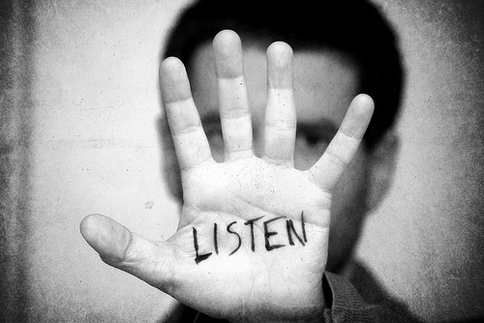
Next step after Monitoring: Social Listening
Monitoring tells you what
Social media monitoring involves tracking and responding to all of the messages sent to or about your company or any of your products and services.
Listening tells you why
Listening is about understanding the bigger picture: Understanding your audience and improving campaign strategy by accessing the full spectrum of conversation around your industry, brand, and any topics relevant to your brand.
Social media monitoring and social media listening are terms that have been used interchangeably, but there is a difference.
Monitoring is the entry point.
Listening is the graduate degree!

Slide 22
The Process of Social Listening / Voice of Customer
Those who can listen well will learn the most. But in the digital age, you no longer need to strain your ears. Today business can use automated tools listen to online conversations.
Especially in social media, where people are constantly talking about products and brands. However, the knowledge gained there must also lead to action.
Cover all relevant Social Media Channels
Align Keywords to be tracked
Define Triggers / Events
GAP / Trend Analysis
Actionable Insights
Identify additional data inputs
Monitor
Prepare &
React
Track and measure KPIs
Ongoing optimization and measurement
Interpret
Respond at individual / aggregate Level
Infuse insights into trainings
Integrate VoC into corporate planning
Listen

Slide 23
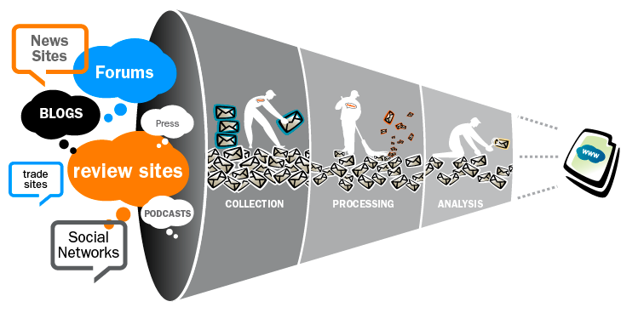
How to listen to social media
Social listening gives brands an opportunity to track, analyze, and respond to conversations about them on social media. It’s a crucial component of audience research.
If you’re not using social listening, you’re leaving a lot of great insights on the table. In fact, you might be missing out on a big piece of insight about your brand that people are actively discussing. You want to know what people are saying about you.
  Identify relevant keywords
  Ask questions and probe
    Identifying your audience’s collective voice can be translated into your marketing or communications strategy.
  Open the floor for co-creation
    Create an open forum for opinions & discussion.
    When brands act like their consumer’s ideas are valuable, brands demonstrate that they’re actively listening.
  Close the loop
    Let your audience know that their voice resulted in change

Slide 24
What else is Social Media Monitoring good for?
Social media monitoring not only provides important information about your own customers, but can also be used to conduct a well-founded competitive analysis or explore general trends.
For example, a changed mood of the customers can also be a suitable early warning indicator.
Social listening allows you to track that sentiment in real time. That way you can see what posts are doing well for your brand, and which ones aren’t. If sentiment is way down, look for the cause and make changes right away, by pulling a problem post, or apologizing for an insensitive Tweet.
Reputation Management
Competitor Analysis
Trend & Market Research
Product Innovation
Crisis Management

Slide 25
5 Core Features of Social Media Listening Tools
Listening Grid
Social Media Monitoring Tools should be able to gather data from many sources and in different forms (e.g. posts, pictures, videos) and establish a listening grid to capture such data.
Dashboards
Dashboards are user interfaces that organize and present information to quickly capture the big picture of monitored topics
Here we will explore the 5 core features of Social Listening tools in order to give you a start for your analysis
Historical Data
Data Analysis
Historical data is necessary to understand the improvement of a strategy in the long-run and through the years.
Analyzing the data and produce actionable reports and insights
Sentiment Analysis
To measure the attitude, opinion, emotional state, or intended emotional communication of a speaker/ writer

Slide 26
Core Features: 1. The Listening Grid
Social Media Listening tools should be able to gather data from many sources and in different forms (e.g. posts, pictures, videos) and establish a listening grid to capture such data.
The Listening Grid should focus on three main aspects
Green
marketing
Green marketing is a practice whereby companies seek to go above and beyond traditional marketing by promoting.
Green
marketing
Marketing
Green
Green
Marketing
Green
marketing
i. Channels
ii. Countries and Languages
iii. Topics of relevance
The topics relevant to the business. Additionally, the listening grid should send alerts to inform clients (e.g. when post volume increases over a defined threshold or sentiment and becomes very negative.
The tool needs to be able to monitor the channels you are using (e.g. blogs and micro-blogs, social networks, video and image websites, etc.)
The tool and the support should be available in your language and your country

Slide 27
Core Features: 2. Data Analysis
Having established a listening grid that captures data and posts around the topics you are interested in, the next step is to analyze the data and produce actionable reports and insights.
The analysis is of particular importance as it encompasses the methods used to both filter the gathered data of unwanted information (e.g. spam, duplicates) and to process it in a way that is meaningful for your company. The analysis should provide:
Brand monitoring and reputation management
Consumer segmentation, customer insight and
market research
Identify specific conversations to join
Gather information about competitors
Support product and service development

Slide 28


Core Features: 3. Sentiment Analysis
The effort of finding valuable information in user-generated data is called opinion mining. Its main purpose is measuring the attitude, opinion, emotional state, or intended emotional communication of a speaker or writer.
A sentiment analysis can be extremely useful in evaluating a large data set of social brand mentions, as well as allow enterprises to filter content based on positive or negative comments, thus isolating the themes or issues that have determined the developed sentiment.
The major method of extracting sentiment from user generated content is Natural Language Processing (NLP). Sometimes called text analytics, data mining or computational linguistics, NLP refers to the computerized process of automatically analyzing the meaning of human language.
The automatic techniques are tireless, fast, consistent (they do not make random errors), and can be improved over time. They offer comparable results to humans in real world scenarios.
Automated sentiment technology cannot reach the quality of a human annotator.
Pros
Cons

Slide 29
Core Features: 4. Historical Data
Exploit the historical data of your monitoring process in order to figure out the strong points of your company throughout the years and the points that hinder the further development.
Access to previously captured data is required to compare the current metrics and reports related to the monitored topic with any previous state of it.
It is necessary to understand the improvement of a strategy in the long-run and through the years.
The user has access only to captured data about topics that he has requested to monitor. Thus, he should proactively monitor topics in order to recognize problems and new opportunities.
Measure the impact of your various online marketing campaigns, compare them and modify them in a productive way.
Discover actionable insights based on the overall image of the enterprise and act in the appropriate way.

Slide 30
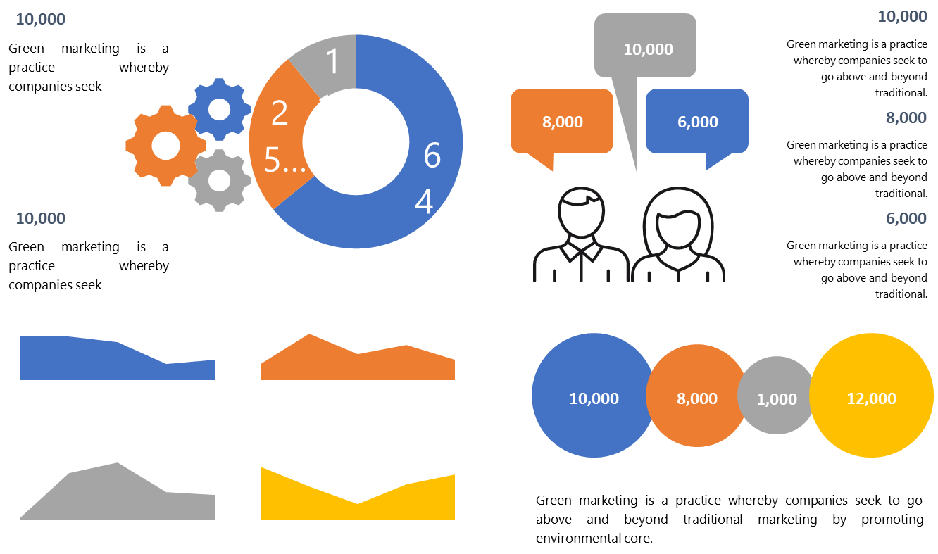
Core Features: 5 Dashboards
A Dashboard is a user interface that organizes and presents information in a manner that is easy to read and use.
.
Quickly captures the big picture of your monitored topics or your brand.
Should be customizable to the needs of the client and provide a wide range of visualization tools.
Offers users graphical representation of the raw data in the form of charts, listings, and historical graphing of queries and phrases
Present information about demographics, trend topics around the monitored subject and insights in an actionable way
.

Slide 31























Tools for Social Media Listening (Overview)
Free | Freemium | Paid
 |  | Ideya lists over 150 Professional Tools in their “Social Media Monitoring Tools and Services Report”
Facebook Insights
LinkedIn Insights
Search (Facebook)
There is a large variety of Social Media Monitoring Tools available.
These tools offer means for listening to the social media users, analyzing and measuring their activity in relation to a brand or enterprise.
Here you can see some examples of tools available on the market (business models might change)

Slide 32

Tools for Social Media Listening (Examples)
Hootsuite is a social media management system for businesses and organizations to collaboratively execute outreach across multiple social networks from one interface. It allows organizations to streamline workflow with scheduling and assignment tools to reach audiences with geo-targeting functionality.
Engage121 helps measure and track social success. It offers tools to boost traffic and engagement as well as target specific groups of users or demographics. The platform allows for the management of multiple brands while keeping communication and workflow separate for each account.

Slide 33
Social Listening Summary
Monitor
Establish a listening grid that will gather everything said and discussed around your brand and the topics that you are interested in
Important parameter is the near-real time gathering of data from the social media
Analyze
Data mining and opinion mining at the gathered data
Sentiment analysis with using NLP in order to classify into categories the gathered conversations
Results
Visualize the insights generated from the analysis with the dashboard tools
Communicate internally the insights to the appropriate department
Engage
Respond to the conversations and give the customers what they want
Take care of the customers. Make them feel important
Consumer opinions and feelings have always mattered – but since the rise of social media, access to them has become even more important AND with tools it is actually much easier to attain. Social media sentiment analysis is now a mainstay of social analytics.

Slide 34
The 5 steps of Managing a Social Media Crisis
On social media, things can move blazingly fast. Sometimes, it’s an Instagram post of a cat going inexplicably viral. But sometimes, it’s a corporate PR crisis that seems to come out of nowhere, but can do irreprovable damage.

Slide 35
STEP 1 – AWARENESS
Taking on board the learning on social listening, start with BEING ALERT and starting to perceive information about your company on social media.
Observe certain keywords and see if the tone of voice changes.
Set up and monitor keywords related to your business
Watch for sudden changes in tone & sentiment
Awareness
Stay on top of conversations about your company using simple tools (see earlier content)
Resolution
Listening
Feedback
Transparency

Slide 36
STEP 2 – LISTENING
Listen and answer. Pay attention to which platforms negative comments are found on. Answer them both directly and at the same time in a more general way.
Invite people to contact you directly via email to solve problems.
Monitor who is talking to you across social media platforms and website comments
Respond, both individually AND more broadly
Use updates on the same platforms where someone talks, and invite them to email if deeper interaction is needed
Awareness
Resolution
Listening
Feedback
Transparency

Slide 37
STEP 3 – TRANSPARENCY
Be honest and transparent if there are problems. Try to solve these problems - if necessary, in smaller steps. Talk about how you will solve the problem.
Awareness
Resolution
Listening
Acknowledge there is a situation
Keep real-time updates flowing
Be honest, empathetic and straightforward with details
Feedback
Transparency

Slide 38
STEP 4 – FEEDBACK
Negative feedback is also important feedback. Don't delete unwanted comments but see them as a chance to show the public how you deal with problems. Give your customers / users the feeling that they are important and become part of the solution.
Awareness
Resolution
Listening
Feedback
Transparency
Be gracious for their feedback and don’t delete negative comments
Answer to questions directly
Make sure customers feel heard by replying, directing them to resources for updates / solutions

Slide 39
STEP 5 – RESOLUTION
Outline the resolution, what was learned, and how similar situations will be prevented in the future
Notify the media for additional outreach
Update social media platforms with outcome, update websites
Awareness
Do not forget to talk about it when the problem is finally solved. Communication of the solution should not be limited to individual platforms.
Resolution
Listening
Feedback
Transparency

Slide 40


WATCH - How to Put a Social Media Crisis management Plan in Place
The Secret to Successful Crisis Management in the 21st Century - Melissa Agnes TEDx Talk
Acknowledgement = HUBSPOT

Slide 41
NEXT UP Module 3
Predicting Financial Distress & Indicators of Crisis across your Business
+ additional resource
Predicting Financial Distress
SPOTLIGHT on Bankruptcy: Z-Score

