Slide 1
MODULE 1
Introduction to Business Crisis
The European Commission support for the production of this publication does not constitute an endorsement of the contents which reflects the views only of the authors, and the Commission cannot be held responsible for any use which may be made of the information contained therein.

Slide 2
What you will learn from Module 01 ..
In Module 01, Introduction to Business Crisis, you will benefit from learning to
Understand the 4 key reasons why a business crisis is complicated
Upskill in the vital process of recognition, setting out the 5 clear stages in recognising a crisis.
Understand the value and impact of an objective external view in a crisis.
Recognise the timeline of a business crisis
In our final section, we provide you with a step by step journey through Value Chain to Crisis Chain with applicable examples.

Slide 3

OVERVIEW
It cannot be denied that size matters, small and medium-sized enterprises (SMEs) are statistically more at risk of business crises than large companies and we look at telling statistics from across Europe.
Throughout our SMART UP Programme, you will learn that crises rarely (never) come overnight and there are often deceptive phases of relaxation which lead management to believe that the crisis has been overcome, when it has not! The more advanced the crisis is, the more difficult and expensive it is to resolve.
"Losing your head in a crisis is a good way to become the crisis." C.J. Redwin

Slide 4
s
What defines a business crisis ? Important definitions
The first step to solving a problem is to know what you have to deal with.
The term crisis is not uniformly defined in the literature - but there is general agreement in both scientific and practical literature when it comes to describing the effects of a crisis on a company.
A business crisis is generally considered to be the state of a company in which its assets are directly threatened and thus its continued existence is at risk. Crisis management can still take place outside of court.
Crisis
In a simplified legal sense: insolvency is the inability to permanently fulfil existing financial obligations. Forms of insolvency are the inability to pay and overindebtedness
Insolvency is by definition a judicial procedure
Insolvency
Turnaround management is the implementation of a series of necessary measures to protect the company from insolvency and return it to operational normality and solvency. Turnaround management usually requires strong leadership and can include restructuring and layoffs, investigation of the root causes of failure & long-term programmes to revive the business.
Turn-
around

Slide 5

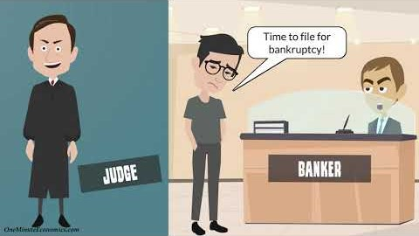
WATCH- Get to know the key definitions
EXERCISE:-
WATCH THIS INSIGHFUL VIDEO FROM ONE MINUE ECONOMICS TO BECOME CLEAR ON THE DEFINITONS INVOLVED.
Source: One Minute Economics | Youtube: https://www.youtube.com/watch?v=ahJgK59g_Ro

Slide 6
s
The 4 key reasons why a business crisis is complicated ..
Overcoming a financial or business crisis is one of the most difficult management tasks of all.
Without external support (e.g. from business advisors, management consultants, lawyers, industry experts) it is often hardly manageable.
No Blueprints
Time Pressure
(No) Data
Knowledge
Every company and every corporate crisis is different. There are no patent remedies or blueprints.
Existential decisions must be made under great time pressure. The further the crisis progresses, the more limited the scope for action and the greater the pressure to act.
The data available is almost always inadequate. The preparation of information to create a basis for decision-making takes up valuable time and resources.
Overcoming a crisis requires a high degree of methodological knowledge, organisational, leadership and communication skills from the people involved.

Slide 7

The vital process of recognition
Setting out the 5 clear stages in recognising a crisis.

Slide 8
s
The Process of Recognition
4. Signs of Relaxation
2 The Hope Principle
If the measures implemented are successful, the first signs of easing are now beginning to appear. However, the restructuring must continue to be implemented consistently.
Successful crisis management depends to a large extent on the openness of the people involved. Warning signals must be recognized and new challenges must be mastered again and again in all phases of the crisis. This requires a high degree of changeability and attention.
The crisis is visible, but management focuses on hope rather than action.
5. Learning + Resilience
If the crisis is successfully overcome, the right conclusions must be drawn. If this is successful, it can lead to sustainable crisis resilience.
3. The Awakening
First Signs
The crisis can no longer be denied. Measures are being implemented under great time pressure. This is the most critical phase.
The first signs of crisis are not realized or not perceived.

Slide 9

1. First signs of a business crisis
A business crisis may have existed for a long time before it is in fact recognised or acknowledged by management. In many cases, confronting the problem is often an extremely stressful experience for those that have to deal with it who may attempt to explain away the emerging signs of crisis. Just some of the early signs are
Debt Dependency
Drop in Sales or Conversions
Negative Numbers in Operating Cash Flow
Operating Income Inadequate to Pay Operating Expenses
Simply ignoring the warning signs and sticking your head deeper into the sand isn’t going to help things at all. In fact, that is probably a fast track to failure! So, make sure you spot the warning signs when they occur and that you are able to act fast on the necessary solutions.

Slide 10

2. The Hope Principle
CEO's and entrepreneurs are typically full of creative ideas and passion, but this can unfortunately lead to false assumptions and mindsets. Overconfidence breeds false hope, which engenders inflated expectations of success. Often businesses are lulled into a false sense of security which has devastating consequences at the time of crisis. You need to take the warning signs of a failing business seriously instead of holding on to hope.
“Will you let me go for Christ's sake? Will you take that phony dream and burn it before something happens?”
Arthur Miller, Death of a Salesman

Slide 11

3. The Awakening
The crisis can no longer be denied. Measures are being implemented under great time pressure. This is the most critical phase. You need focus on detail and crystal-clear planning. Many businesses find their way back from crisis. To do this, you’ll have to make some difficult decisions and you will need to take decisive action to save your business.
Be aware of the details of all people, parties, stakeholders, customers. employees and suppliers etc., who will be affected and how. Take the action you need to take. These situations most often do not fix themselves and there is a point of no return. SEE THE VALUE OF EXTERNAL ADVISOR IN THIS MODULE

Slide 12
Spotlight on Mistakes
Practical Tip: Keep the Powder Dry
With regard to financing in crisis, business often make serious mistakes.
A significant mistake is to invest one's private assets too early and too extensively in the company. Even if the intention of the owners behind this is laudable, it often leads to irreparable damage.
It is therefore important to first draw up a comprehensive restructuring plan and then to finance and implement it together with the banks.
STEP
The owner invests private money in the crisis because they want to save their company. They hope that the situation will change again with the next major contract.
01
The liquidity situation in the company is initially more relaxed again. As a rule, however, no far-reaching restructuring measures are implemented. The principle of hope continues to prevail - the problem is just postponed.
STEP
02
STEP
When the last of their own reserves have been used up, the entrepreneur seeks capital from banks. Banks usually require significant personal contributions from the owner if they are to provide support during the crisis. However, if the powder has already run out, this option is denied - and insolvency is often the logical consequence.
03

Slide 13
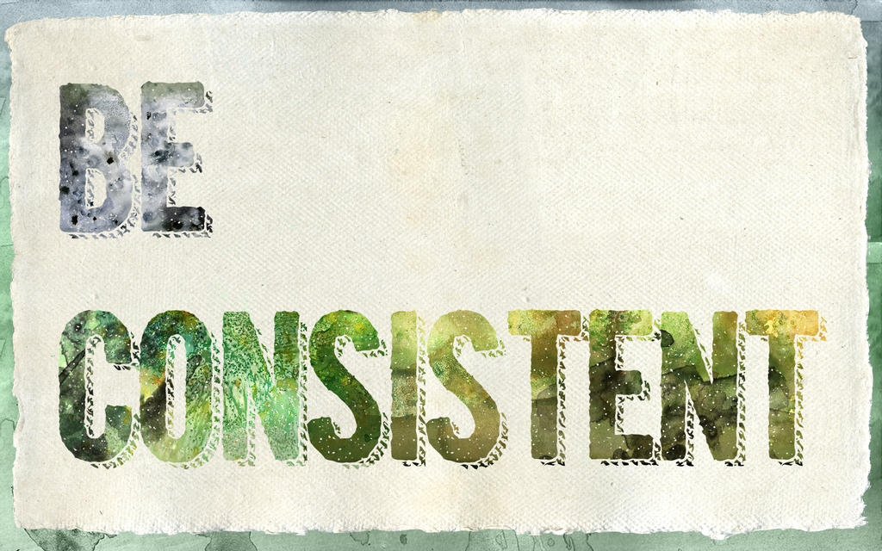
4. Signs of Relaxation
If the measures implemented are successful, the first signs of easing are now beginning to appear.
However, the restructuring must continue to be implemented consistently.

Slide 14

Back from the brink ? The story of Evernote
Some of the world’s most successful start-ups have come very close to financial ruin only to spectacularly pull themselves back from the edge. A prime example is Evernote, the San Francisco software firm. The company found itself with just three weeks’ worth of cash left in 2008 when a key investor pulled out as the financial crisis struck. The painful decision was taken to close the company and save money for the legal costs involved in a shutdown. However, after an avid Evernote user in Sweden invested up half a million dollars, the start-up got itself back on track, amassed 100 million users worldwide and was recently valued at $1bn.
READ: How 5 Big Brands Came Back from the Brink of Failure

Slide 15
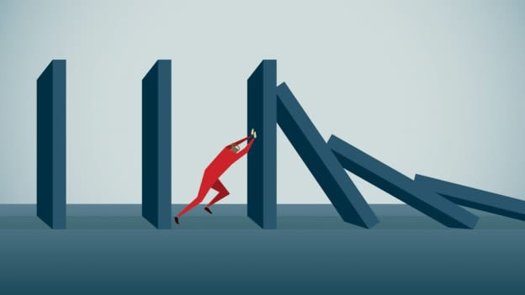
5. Learning and Resilience
If the crisis is successfully overcome, the right conclusions must be drawn. If this is successful, it can lead to sustainable crisis resilience.
“I’m convinced that about half of what separates the successful entrepreneurs from the non-successful ones is pure perseverance. It is so hard and you pour so much of your life into this thing, there are such rough moments in time that most people give up. And I don't blame them, it's really tough.”
Steve Jobs, Apple co-founder

Slide 16
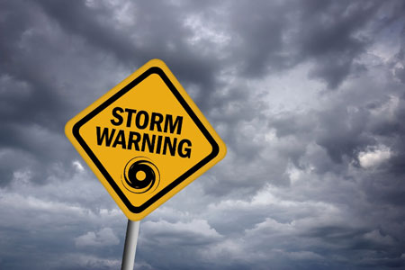
Let’s look at the context of business crisis in Europe. Did you know that
Size matters ?
Age matters ?
Sector matters ?

Slide 17
IN CONTEXT - Size Matters: Insolvencies by Size Categories
Small and medium-sized enterprises (SMEs) are statistically more at risk of business crises than large companies.
Do you know what the statistics are in your country ?
Source: Creditreform

Slide 18
Age matters: Insolvencies by Company Age
It is a sad fact that especially young companies are in danger of insolvency. The reasons for this lie both in their lower capital resources and in their inexperience in dealing with crises.
Source: Creditreform

Slide 19
Industry matters: Insolvencies by Sector
Some industries are more risky than others. These are often those industries in which smaller companies tend to be active.
Source: Creditreform

Slide 20
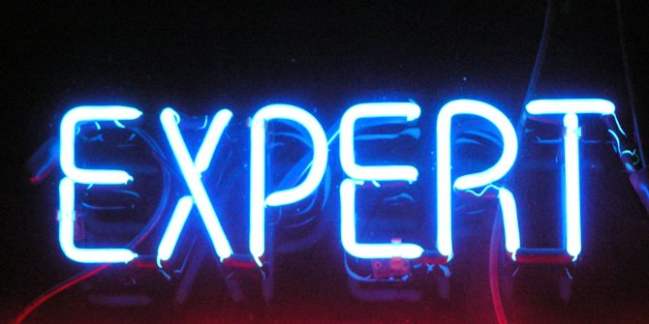
Understand the value and impact of an objective external view in a crisis.

Slide 21
The Value of External Perspective
External Factors | Perceptual asymmetry | Internal Factors
Shrinking / saturated markets |  | Strategy deficits
Digitization |  | Outdated technology / products
Changes in regulations |  | Lack of operational efficiency
Technology leaps |  | Insufficient management / leadership quality
Globalization |  | Unbalanced financing structure
New products / new competitors |  | Overpriced acquisitions
Raw material prices / exchange rates |  | Insufficient controlling
Insolvencies of customers / suppliers |  | Organizational deficiencies
If one asks the management about the causes of the crisis, the acting persons usually arrive at completely different attributions of causes than external consultants.
While management naturally tends to attribute the crisis to external factors and sees few mistakes internally, an external view from consultants is often contradictory.
An objective view from outside is particularly helpful in a crisis.
Perception of Management
90%
external
10%
internal
Perception of Advisors
10%
external
90%
internal

Slide 22

The timeline of a business crisis

Slide 23
Crises rarely (never) come overnight
Objective identifiability
of the crisis (in %)
Core problems:
Business leaders react with a large time delay
If the leaders indicate a crisis, the causes of the crisis have often already taken full effect (and cannot be remedied in the short term)
Permanent risk analysis required
Crisis in operating
results
Liquidity Crisis
Tíme
Source: Roland Berger – based on an Analysis of 800 Restructuring Cases

Slide 24
Simplified Course Model of Crises
The beginning of the crisis
End of the crisis – continued existence
Business crises often run in waves. In the meantime, there are often deceptive phases of relaxation which lead management to believe that the crisis has been overcome.
Implementation of
restructuring measures
Potential
turning point
Probability of survival
Turning Point
End of the crisis
- liquidation /
discontinuation of
business operations
Potential
turning point
Time

Slide 25
The Typical Course of a Crisis
Business crises usually follow a very typical course. In practice, the individual phases can be of varying length - and sometimes a phase is skipped.
As a rule, the more advanced the crisis is, the more difficult and expensive it is to resolve.
Later in this module we will deal with the individual phases in detail.
Utilized credit lines
waiver of discounts
Increase in liabilities due
Payment delay /
advance payment
Supply bottlenecks
Insolvency risk
Impending insolvency
Over-indebtedness occurred
Occurred insolvency
Revenue /
Profit /
Liquidity
Stakeholder
Crisis
Strategy Crisis
Product / Sales Crisis
Earnings Crisis
Liquidity Crisis
Insolvency
Sustainable
conflicts at
stakeholder level:
shareholders, employees,
banks, etc.
Blockade of
essential decisions
Acceptance of negative developments
No clear vision
Inadequate customer orientation
Products at maturity
Missed technological developments / inadequate vertical integration
Company is still making profits
Decline in sales
Price and margin pressure
Rising stocks and
Capital tied up
Capacity underutilisation
Earnings decline if no countermeasures implemented
Decline in sales continues
Company reacts with "cost-cutting
Decline in profit / losses / decrease in equity
Raising capital becomes more difficult (credit rating declines)

Slide 26
Typical Cause-and-Effect Relationships vs. Direct Entry
Uncertainty about succession / management
No / wrong mission statement
No competitiveness
Consumption of assets (decrease in equity ...)
No reserve(s) / financial scope
Loss of Decision-Making Authority
The entry into a business crisis is independent of the crisis phase "currently" identified.
An immediate entry into advanced phases - usually triggered by external
effects - is also possible
Weak leadership
Products not in line with the market
Decline in earnings
Consumption of liquid funds
(Impending) insolvency
Stakeholder
Crisis
Strategy Crisis
Product / Sales Crisis
Earnings Crisis
Liquidity Crisis
Insolvency
Loss of a major customer / order
Claims for damages
Massive loss of receivables
Direct occurrence
of crisis (external triggers)

Slide 27
Pressure to react
Problem Areas and Pressure (examples)
Within the ideal typical course of a business crisis, the problem areas to be solved AND the pressure to react increase.
Liquid Funds?
Equity?
Equity?
Products?
Products?
Products?
Mission Statement?
Mission Statement?
Mission Statement?
Mission Statement?
Succession?
Succession?
Succession?
Succession?
Succession?
Stakeholder
Crisis
Strategy Crisis
Product / Sales Crisis
Earnings Crisis
Liquidity Crisis
Insolvency

Slide 28
Understand the causes of crisis across the Business Value Chain

Slide 29
Identifying causes of crisis: across all elements of the
Value Chain
Causes for business crises can also be found across all divisions in the value chain of the business. The value chain represents the stages of production as an ordered sequence of activities. These activities create value, consume resources and are linked together in processes. The concept was first published in 1985 by Michael E. Porter in his book Competitive Advantage:
"Every company is a collection of activities through which its product is designed, manufactured, distributed, delivered and supported. All these activities can be represented in a value chain.“
PRIMARY ACTIVITIES
OUTBOUND LOGISTICS
INBOUND
LOGISTICS
OPERATIONS
MARKETING
AND SALES
SERVICE
VALUES
FIRM INFRASTRUCTURE
HUMAN RESOURCE MANAGEMENT
TECHNOLOGY DEVELOPMENT
PROCUREMENT
SUPPORT ACTIVITIES

Slide 30
From Value Chain to Crisis Chain (Examples)
The causes of a business crisis can lie in all areas of the company. As a rule, a crisis cannot be traced back to singular issues but to a multi-causal connection.
Potential Causes of a crisis as a result of firm’s infrastructure :
PRIMARY ACTIVITIES
Unbalanced financing
Disagreement in leadership
Insufficient control
Organizational deficiencies
INBOUND
LOGISTICS
OPERATIONS
OUTBOUND
LOGISTICS
MARKETING
AND SALES
SERVICE
Crisis
FIRM INFRASTRUCTURE
HUMAN RESOURCE MANAGEMENT
TECHNOLOGY DEVELOPMENT
PROCUREMENT
SUPPORT ACTIVITIES

Slide 31
From Value Chain to Crisis Chain (Examples)
The causes of a business crisis can lie in all areas of the company. As a rule, a crisis cannot be traced back to singular issues but to a multi-causal connection.
Potential Causes of a crisis as a result of HR:
PRIMARY ACTIVITIES
INBOUND
LOGISTICS
OPERATIONS
OUTBOUND
LOGISTICS
MARKETING
AND SALES
SERVICE
Insufficient human resources development
Mismatch of skills in key positions
Overstaffed or understaffed
Lack of incentives
Lack of responsibilities
No performance principle
Crisis
FIRM INFRASTRUCTURE
FIRM INFRASTRUCTURE
HUMAN RESOURCE MANAGEMENT
TECHNOLOGY DEVELOPMENT
PROCUREMENT
SUPPORT ACTIVITIES

Slide 32
From Value Chain to Crisis Chain (Examples)
The causes of a business crisis can lie in all areas of the company. As a rule, a crisis cannot be traced back to singular issues but to a multi-causal connection.
Potential Causes of a crisis as a result of technology development
PRIMARY ACTIVITIES
INBOUND
LOGISTICS
OPERATIONS
OUTBOUND
LOGISTICS
MARKETING
AND SALES
SERVICE
Outdated or not fit for purpose technology
No or no systematic R&D
Insufficient customer orientation
No R&D controlling
Obsession with detail
Crisis
FIRM INFRASTRUCTURE
FIRM INFRASTRUCTURE
HUMAN RESOURCE MANAGEMENT
HUMAN RESOURCE MANAGEMENT
TECHNOLOGY DEVELOPMENT
PROCUREMENT
SUPPORT ACTIVITIES

Slide 33
From Value Chain to Crisis Chain (Examples)
The causes of a crisis can lie in all areas of the company. As a rule, a crisis cannot be traced back to singular issues but to a multi-causal connection.
Potential Causes of a crisis as a result of purchasing/ procurement crisis:
PRIMARY ACTIVITIES
INBOUND
LOGISTICS
OPERATIONS
OUTBOUND
LOGISTICS
MARKETING
AND SALES
SERVICE
Crisis
No systematic sourcing
Unilateral dependence
Unsecured contracts
Quality, delivery reliability, financial situation
FIRM INFRASTRUCTURE
FIRM INFRASTRUCTURE
HUMAN RESOURCE MANAGEMENT
HUMAN RESOURCE MANAGEMENT
TECHNOLOGY DEVELOPMENT
PROCUREMENT
SUPPORT ACTIVITIES

Slide 34
From Value Chain to Crisis Chain (Examples)
The causes of a crisis can lie in all areas of the company. As a rule, a crisis cannot be traced back to singular issues but to a multi-causal connection.
Potential Causes of a crisis as a result of inbound logistics:
PRIMARY ACTIVITIES
INBOUND
LOGISTICS
OPERATIONS
OUTBOUND
LOGISTICS
MARKETING
AND SALES
SERVICE
Changes and inconsistencies in supply chain
Lack of inventory
management
No incoming goods
inspection
Overstocking
Crisis
FIRM INFRASTRUCTURE
FIRM INFRASTRUCTURE
HUMAN RESOURCE MANAGEMENT
HUMAN RESOURCE MANAGEMENT
TECHNOLOGY DEVELOPMENT
PROCUREMENT
SUPPORT ACTIVITIES

Slide 35
From Value Chain to Crisis Chain (Examples)
The causes of a crisis can lie in all areas of the company. As a rule, a crisis cannot be traced back to singular issues but to a multi-causal connection.
Potential Causes of a crisis as a result of Operations
Low productivity
Outdated or unproven technology
Unstable processes
High wastage rates
PRIMARY ACTIVITIES
INBOUND
LOGISTICS
OPERATIONS
OUTBOUND
LOGISTICS
MARKETING
AND SALES
SERVICE
Crisis
FIRM INFRASTRUCTURE
FIRM INFRASTRUCTURE
HUMAN RESOURCE MANAGEMENT
HUMAN RESOURCE MANAGEMENT
TECHNOLOGY DEVELOPMENT
PROCUREMENT
SUPPORT ACTIVITIES

Slide 36
From Value Chain to Crisis Chain (Examples)
The causes of a crisis can lie in all areas of the company. As a rule, a crisis cannot be traced back to singular issues but to a multi-causal connection.
Potential Causes of a crisis as a result of Operations
PRIMARY ACTIVITIES
No stock management
Lack of process management
Service provider unsatisfactory
Overcapacity
Vehicle fleet costs
External and political changes e.g. Brexit
INBOUND
LOGISTICS
OPERATIONS
OUTBOUND LOGISTICS
MARKETING
AND SALES
SERVICE
Crisis
FIRM INFRASTRUCTURE
FIRM INFRASTRUCTURE
HUMAN RESOURCE MANAGEMENT
HUMAN RESOURCE MANAGEMENT
TECHNOLOGY DEVELOPMENT
PROCUREMENT
SUPPORT ACTIVITIES

Slide 37
From Value Chain to Crisis Chain (Examples)
The causes of a crisis can lie in all areas of the company. As a rule, a crisis cannot be traced back to singular issues but to a multi-causal connection.
Potential Causes of a crisis as a result of marketing + sales
PRIMARY ACTIVITIES
INBOUND
LOGISTICS
OPERATIONS
LOGISTICS
MARKETING
AND SALES
SERVICE
Uncontrolled growth
Unilateral dependence on customers (cluster risk)
Insufficient price calculation
Marketing Wastage
Weak sales pipeline
Over reliance on small number of customers
Crisis
FIRM INFRASTRUCTURE
FIRM INFRASTRUCTURE
HUMAN RESOURCE MANAGEMENT
HUMAN RESOURCE MANAGEMENT
TECHNOLOGY DEVELOPMENT
PROCUREMENT
SUPPORT ACTIVITIES

Slide 38
From Value Chain to Crisis Chain (Examples)
The causes of a crisis can lie in all areas of the company. As a rule, a crisis cannot be traced back to singular issues but to a multi-causal connection.
Potential Causes of a crisis as a result of Service
No customer feedback
(or no reaction to feedback)
Inadequate processing of defects
Product callbacks
PRIMARY ACTIVITIES
INBOUND
LOGISTICS
OPERATIONS
LOGISTICS
MARKETING
AND SALES
SERVICE
Crisis
FIRM INFRASTRUCTURE
FIRM INFRASTRUCTURE
HUMAN RESOURCE MANAGEMENT
HUMAN RESOURCE MANAGEMENT
TECHNOLOGY DEVELOPMENT
PROCUREMENT
SUPPORT ACTIVITIES

Slide 39

Module 01 – key exercise
Complete your own Assessment of Value Chain to Crisis Chain
Download our WorkBook

Slide 40
Next up: Module 2 Scanning for Early Warning Signs
www.smartupproject.eu

